Slide 1
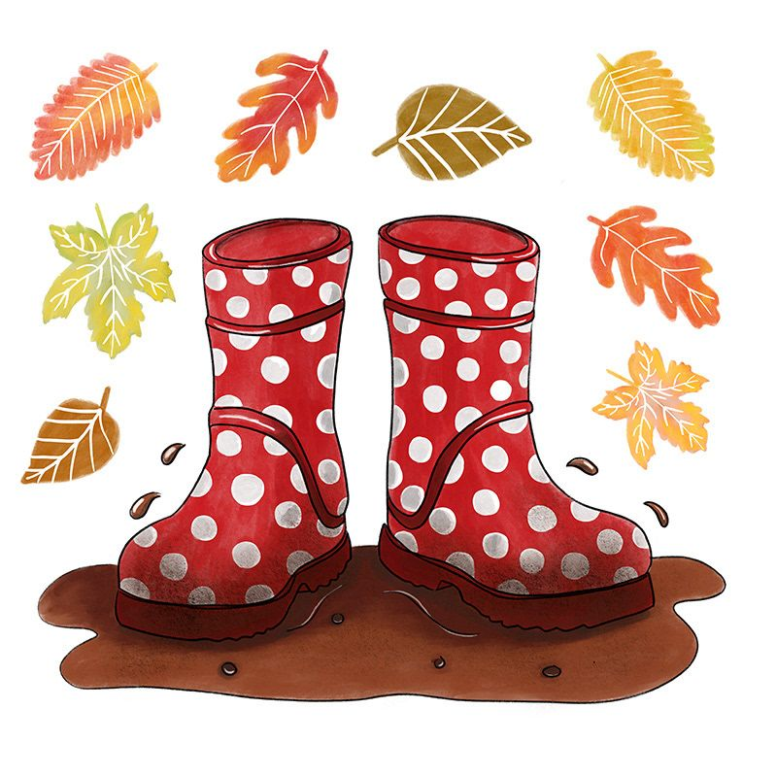
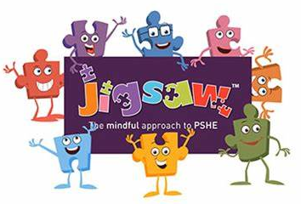
Roots, Shoots & Muddy Boots! Year 1 Spring 2 2025
The intent of this topic is to learn about living things and know what things need grow and thrive.
Science
We will be learning about what plants need to grow. We will be planting seeds and bulbs, take care of them and watch them grow.
The children will learn about the main parts of flowers and trees. We will be labelling common plants and trees. We will also be learning about things that are living, dead and things that have never lived.
Literacy
We will be sharing the story 'Oliver's Vegetables' and looking at non-fiction texts about plants. We will be writing a recount of Oliver’s visit to Grandpa’s house. We will be learning to spell the days of the week for our recount writing.
We will also be taking part in the Hampshire Picture Book Awards. We will be sharing 4 new pictures books up for the award this year and be doing fun activities related to each book. The children will then vote for their favourite book, votes will be sent off to Hampshire Awards. The winner will be announced later in the Spring.
Maths
We will be learning to tell the time by the hour and half past the hour. We will be using the language of heavier and lighter to compare objects weight.
We will continue to count in 2s, 5s & 10s. We will be looking at simple multiplication through repeated addition and simple division through sharing.
We will also be solving addition and subtraction problems and recording number sentences using the + - & = signs.
We will be looking at coins and their value.
Art
Observational drawing & painting = we will be looking closely at plants, flowers & vegetables. We will then be drawing and painting what we can see.
We will be learning about Andy Warhol and exploring tile printing. We will be printing using repeating patterns.
PE – (Tuesdays & Wednesdays)
We will be learning team and target games.
Geography
We will be continuing to learn about the UK focusing on Wales & Northern Ireland this half term.
History
We will be continuing to learn about the Explorer ‘Neil Armstrong’ and the Moon landing.
RE
We will be learning about the feelings happy and sad.
We will be looking at the Easter story and how it is important to Christians.
Music
Voice – singing focus, looking at structure, dynamics and tempo of music.
Outdoor Learning
We will be continuing to look for seasonal changes and exploring nature.
We will be looking closely at types of trees (deciduous and evergreen) and the signs of Spring.
DT
We will be learning about where fruit comes from, designing and making fruit kebabs.
Jigsaw – PSED
We will be learning about healthy eating and living.
Computing
We will be learning to use the direction keys to complete the challenges successfully. We will also be learning to create and debug a set of instructions (algorithm).
Red text are SMSC opportunities (Social, moral, social and cultural)

